Slide 1

Mustang microsite – main navigation
Home | What is Mustang? | How does Mustang impact you? | More information
Intro to Mustang
Rolling banner: tech fair, recording links to townhall
Key contacts
Overview
Simcorp
Jacobi
Microsoft Dynamics
GI-Ops
Portfolio Management Group
Client-facing teams (TFS and SPS)
Change Champions
Timeline
Key Contacts
Other resources

Slide 2
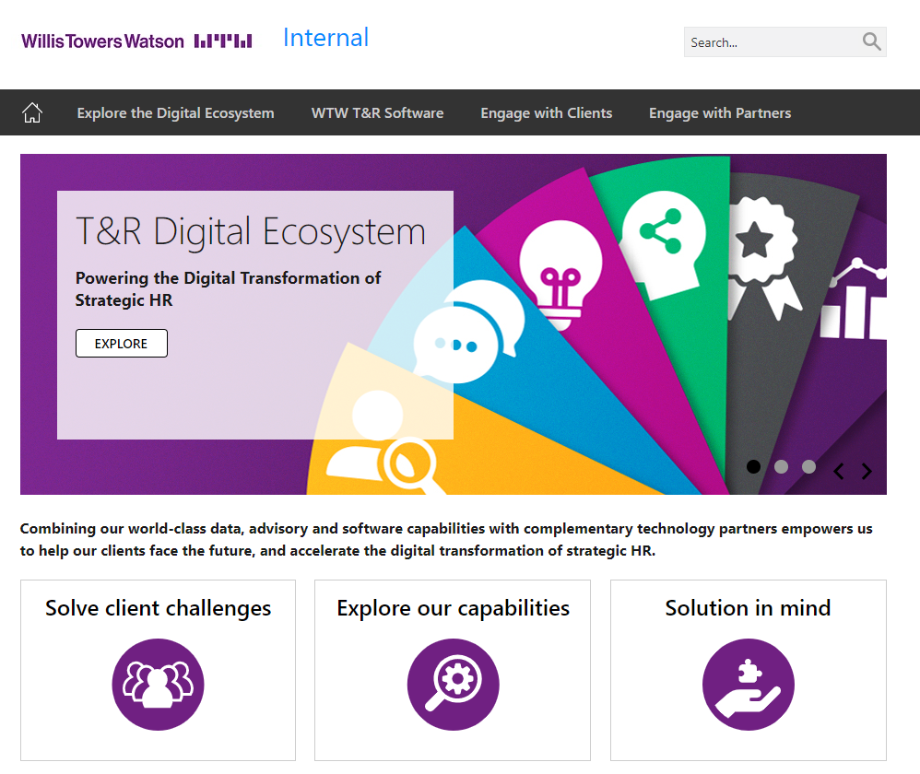
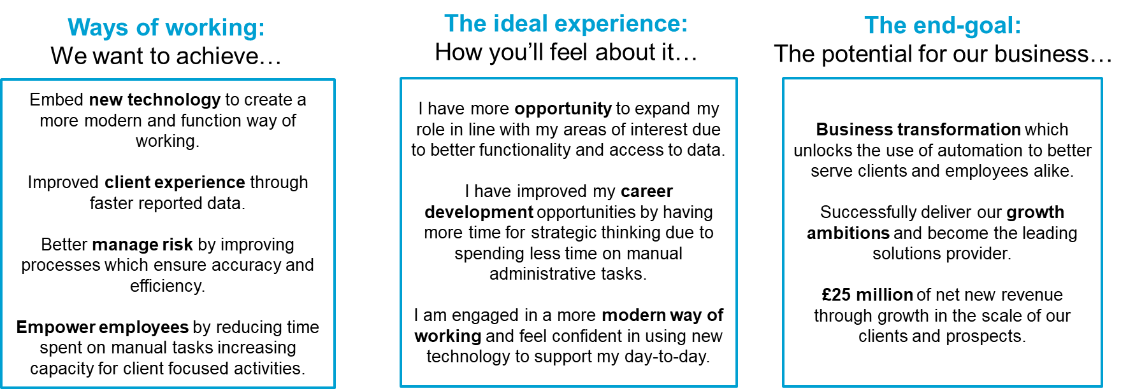
Home page
Rolling banner
Tech fair
New uploads i.e. recording links to townhalls
Intro to Mustang
Identified and set up three new external technology platforms to improve ways of working, working with external partners to achieve the best possible solutions: Simcorp, Jacobi, Microsoft Dynamics.
Key Contacts
Program Lead
Business Owners
Training and UAT

Slide 3
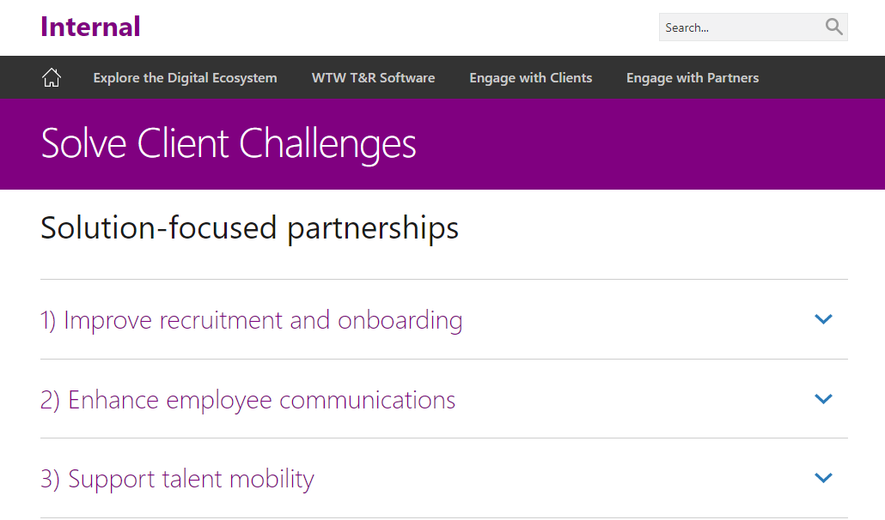
What is Mustang
Overview
Across 2020, we will implement software and tools across portfolio management, client management and operations to improve the way we deliver for clients. We hope to be able to build different elements of the infrastructure change in parallel to keep the implementation to our target timeline. For each technology we’ll undergo extensive testing, train colleagues and bring in change champions to support you as we make the transition.
Simcorp
A front to back Investment Management system that will drives efficiencies across front to back office processes, as well as provide the most up to date position data for our client portfolios and ultimately improve the performance and reporting experience for us and our clients. Link to training materials.
2) Jacobi
Allow PMG to conduct faster, more automated, portfolio modelling and enable greater access to risk data & analytics within the same, integrated solution as where the data they’re working with is housed. Link to training materials.
3) Microsoft Dynamics
Enabling us to manage client data more efficiently, and therefore manage our client relationships more effectively.
Embed Dynamics into our ways of working to introduce automation into workflow tasks where possible and better access to management information to drive the business. Link to training materials.

Slide 4
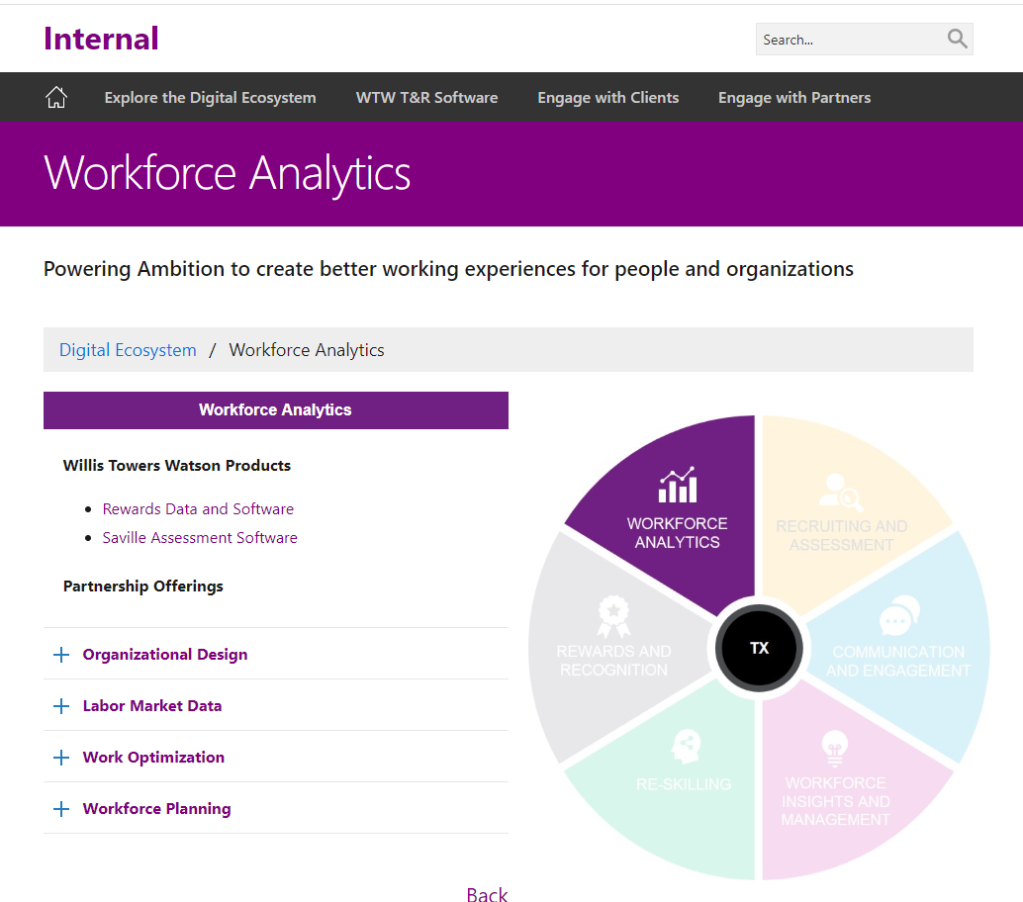
How does Mustang impact you?
GI-Ops
KEY MESSAGES: Why, What, How, when?
Portfolio Management Group
KEY MESSAGES: Why, What, How, when?
Client-facing teams (TFS and SPS)
KEY MESSAGES: Why, What, How, when?

Slide 5
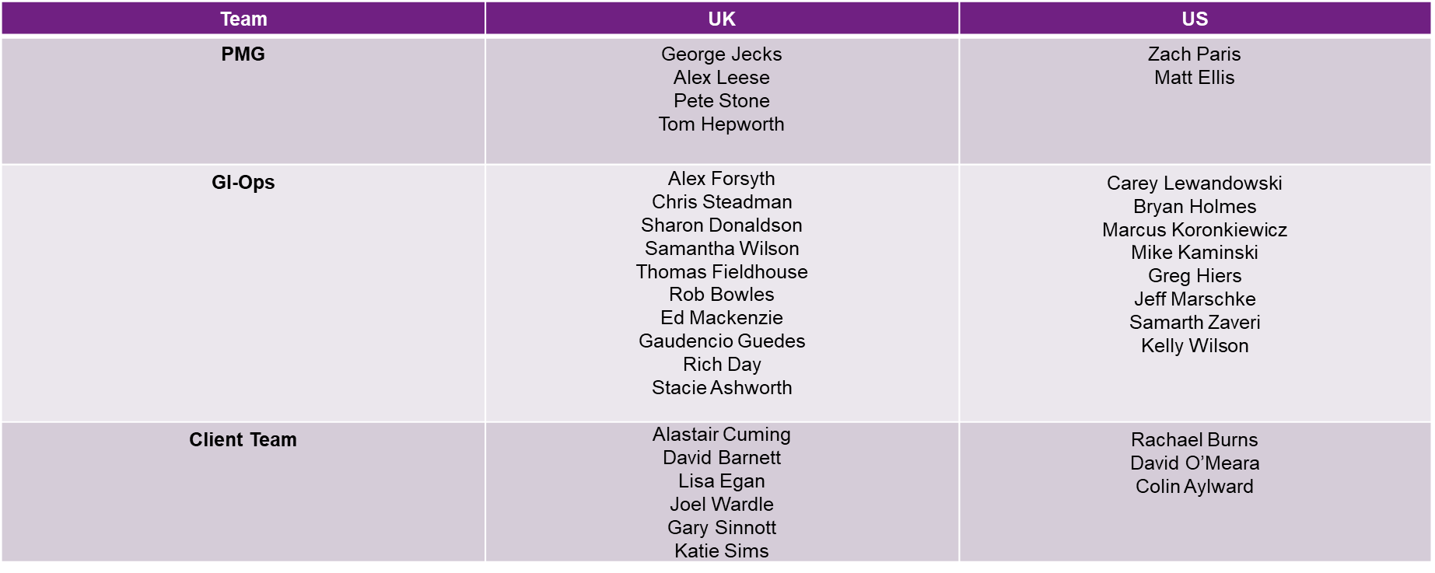
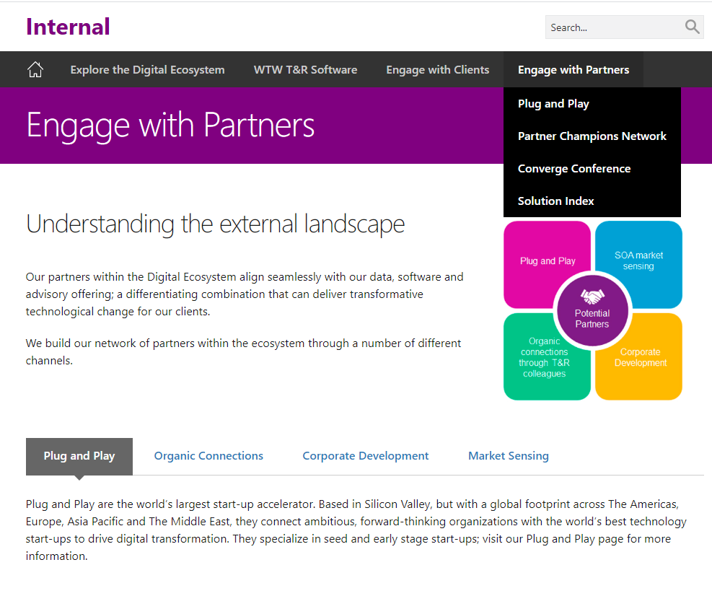
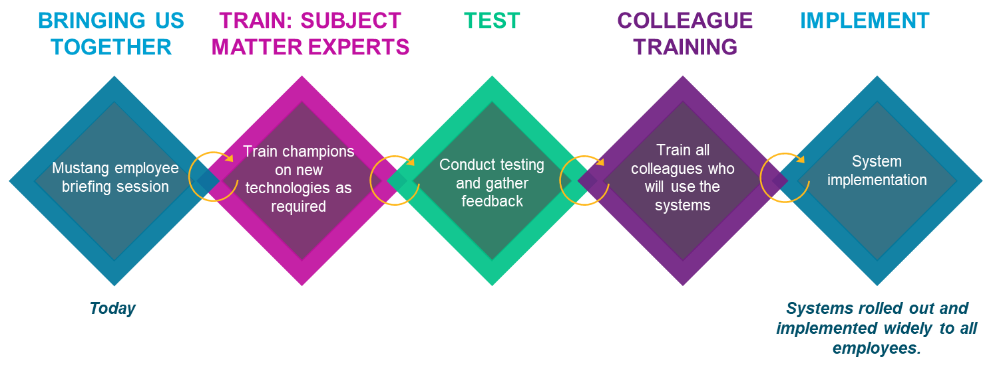
More information
Change Champions
Timeline
Key Contacts
Program Lead
Business Owners
Training and UAT
Other resources
Link to: employee briefing deck, software external website?

